Slide 1
RIAK
Tech guide

Slide 2
installation
Segui la guida:
https://riak.com/posts/technical/running-riak-in-docker/index.html?p=12629.html
Vedi il menu di configurazione admin
http://localhost:8098/admin/#/cluster/default/data
Altre guide:
https://riak.com/products/riak-kv/
USA REAK

Slide 3
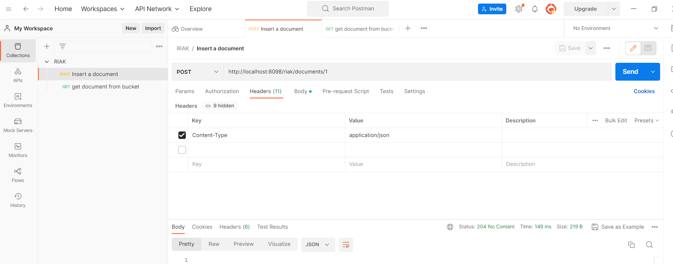
Postman insert

Slide 4
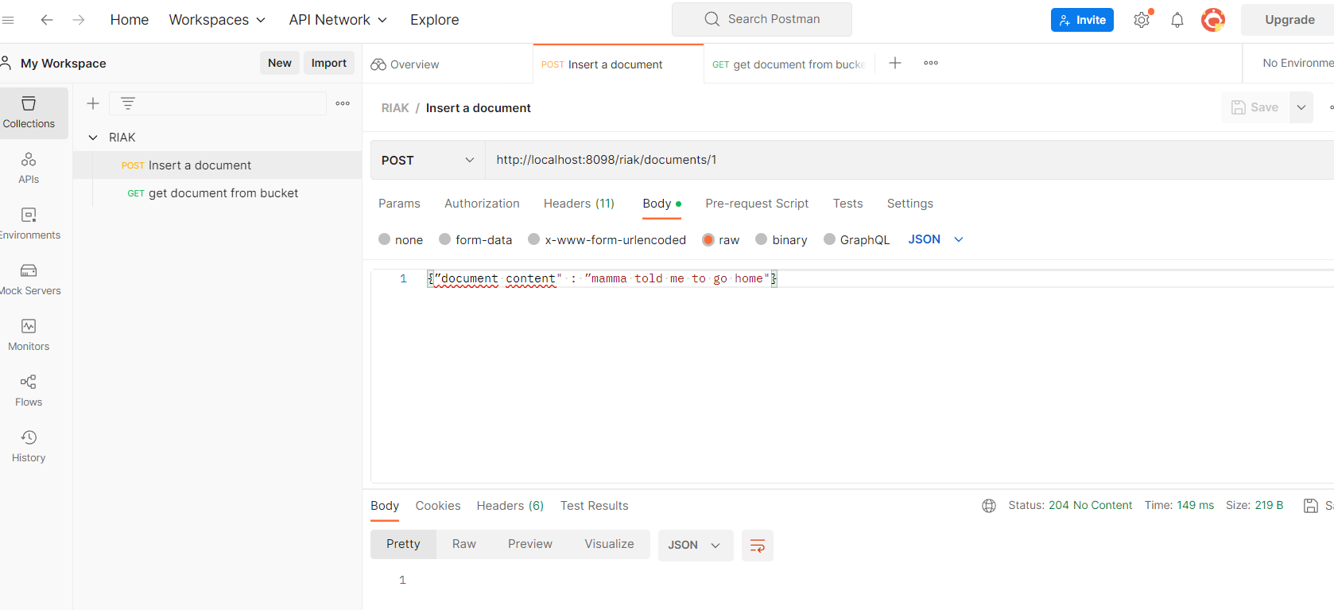
Postman insert

Slide 5
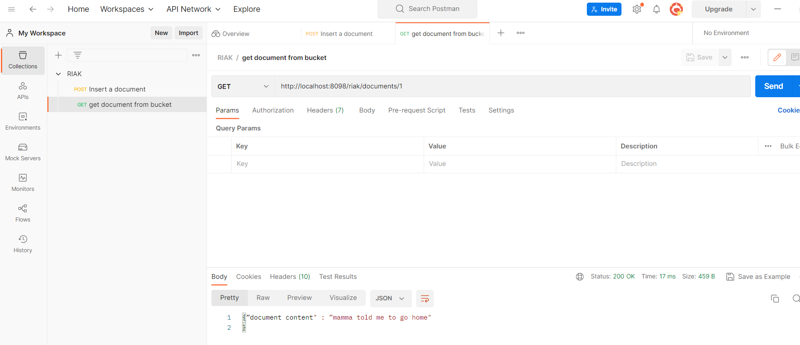
Postman get

